Slide 1


Slide 2
Course objective
This course introduces basic concepts for database design.
Students will learn the main features of different DBMSs in the market.
It focuses on building ERD using practical case studies.
It explores how to build a relational database from the logical database design.
This course covers how to design, build and query a relational database.
They will apply normalization to data for effective, stable database design.
Students will learn basic concepts of Structured Query Language (SQL) .

Slide 3
Day1
DB Life cycle
File Based System & its Disadvantages and Limitations
DBMS Advantages & Disadvantages
ERD Notations
Entities & Attributes & relations
Keys & Constraints
Case Study
ERD Concepts

Slide 4
Day2
Mapping Definitions & Schema Rules
SuperTypes & SubTypes
Case Study
SQL Fundamentals
  DDL
  DML
  DCL
ERD Concepts

Slide 5
Day3
SQL Part_II
Normalization
    1NF
    2NF
    3NF
  Case Study
Database Objects
Database backup and recovery
DB Security & Admin Roles
Log File and Transaction
OLAP & OLTP
ERD Concepts

Slide 6
Systems Development Life Cycle
Problem identification
Analysis
Logical Design
Physical Design
Mapping
Implementation
Testing & Maintenance

Slide 7
File Based System
Separation & Isolation Of data (each user has a copy) cause inconsistencies
Incompatible File Formats
Program-Data Dependence
  All programs maintain metadata for each file they use
  Each application program needs to include code for the metadata of each file
  Non-standard file formats
Lengthy Development Times
  Programmers must design their own file formats (Metadata)
Data Redundancy (Duplication of data)
  Different systems/programs have separate copies of the same data
  When data changes in one file, could cause inconsistencies
  No Database integrity
Limited Data Sharing
  No centralized control of data
ERD Concepts

Slide 8
Basic Definitions
Data: A collection of related information.
  raw facts (e.g., "Ali, 20, Cairo")
Database: A collection of related data stored (systematically) for easy access, management, and updating.
Database Management System (DBMS): A software package/ system to facilitate the creation and maintenance of a computerized database.(model introduced in 1970 IBM but RDBMS appears in1980)
Database System: The DBMS software together with the data itself. Sometimes, the applications are also included. ( Software + Database )

Slide 9
Database System
Users
Database System
Application Programs
Software to process
Queries
DBMS Software
Software to access Stored Data
Stored DB
Definition
(Metadata)
Stored
Database

Slide 10
Types of Databases
Relational Databases (RDBMS): MySQL, PostgreSQL, Oracle, SQL Server.
NoSQL Databases: MongoDB, Redis, Cassandra.
ERD Concepts

Slide 11
DBMS Advantages
Standardization and better Data accessibility and response (SQL)
  Sharing data.
    Different users get different views of the data
Enforcing Integrity Constraints
Improved Data Quality
  Constraints, data validation rules
Inconsistency can be avoided because of data sharing.
Restricting Unauthorized Access.
Providing Backup and Recovery.
    Disaster recovery is easier
Minimal Data Redundancy
    Leads to increased data integrity/consistency
Program-Data Independence
      Metadata stored in DBMS, so applications don’t worry about data formats
      Data queries/updates managed by DBMS

Slide 12
DBMS Disadvantages
It needs expertise to use
DBMS itself is expensive
The DBMS may be incompatible with any
other available DBMS
ERD Concepts

Slide 13
Database Users
Database Administrator (DBA)
System Analysts
Database Designer
Database Developer
Application programmers
BI & BigData Specialist (Data Scientist)
End users
ERD Concepts

Slide 14
Three Level/Schema Architecture
A data model is a representation of reality
External – What the user sees: focus on what different types of users will see when viewing the database. They are concerned with what data the user will see and how the data will be presented to the user.
Conceptual – The logical model: focus on the logical nature of the data representation. They are concerned with what is represented rather than how it is represented.(define database structures such as tables and constraints)
Internal – The physical model: place the emphasis on how the data are represented in the database or on how the data structures are implemented.
ERD Concepts
Notes:
Database Model: a collection of logical constructs used to represent the data structure and the data relationships found within the database.
User models focus on what different types of users will see when viewing the database. They are concerned with what data the user will see and how the data will be presented to the user.
Logical models focus on the logical nature of the data representation. They are concerned with what is represented rather than how it is represented.
Physical models place the emphasis on how the data are represented in the database or on how the data structures are implemented.
External – What the user sees: deals with methods through which users may access the schema, such as through the use of a data input form. The external model allows relationships to be created between the user application and the data model.
Conceptual – The logical model: is the basic database model, which deals with organizational structures that are used to define database structures such as tables and constraints.
Internal – The physical model: deals with the physical storage of the database, as well as access to the data, such as through data storage in tables and the use of indexes to expedite data access. The internal model separates the physical requirements of the hardware and the operating system from the data model.

Slide 15
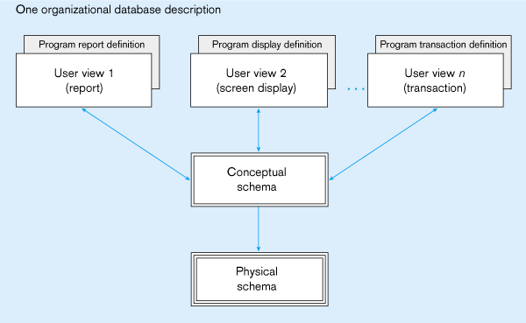
Three Level/Schema Architecture
External schema
Different people have different views of the database…these are the external schema
Internal schema
ERD Concepts

Slide 16


Slide 17
Entity Relationship Modeling
Entity-Relationship Diagram (ERD)
identifies information required by the business by displaying the relevant entities and the relationships between them.

Slide 18
The ER Model
Basic constructs of the E-R model:
  Entities - person, place, object, event, concept (often corresponds to a real time object that is distinguishable from any other object)
  Attributes - property or characteristic of an entity type (often corresponds to a field in a table)
  Relationships – link between entities (corresponds to primary key-foreign key equivalencies in related tables)
ERD Concepts

Slide 19
ER Diagram: Starting Example
access-date
cust-name
number
cust-id
has
customer
account
cust-street
cust-city
balance
Rectangles: entity sets (nouns)
Diamonds: relationship sets (verbs)
Ellipses: attributes (nouns)
ERD Concepts

Slide 20
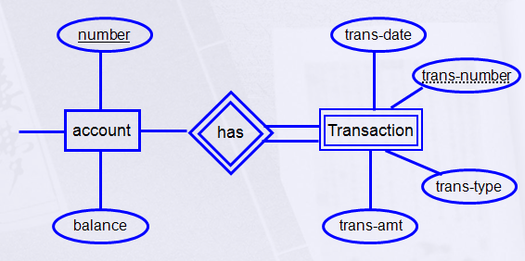
Strong Entity Vs Weak Entity
A Strong Entity- An Entity set that has a primary key.
A Weak Entity- An entity set that do not have sufficient attributes to form a primary key.
Partial key: A set of attributes that can be associated with P.K of an owner entity set to distinguish a weak entity.
Notes:
Weak entity
An entity that does not have a key attribute
A weak entity must participate in an identifying relationship type with an owner or identifying entity type
Entities are identified by the combination of:
A partial key of the weak entity type
The particular entity they are related to in the identifying entity type
Example:
Suppose that a DEPENDENT entity is identified by the dependent’s first name and birth date, and the specific EMPLOYEE that the dependent is related to. DEPENDENT is a weak entity type with EMPLOYEE as its identifying entity type via the identifying relationship type DEPENDENT_OF

Slide 21
Next: Types of Attributes
Composite Attribute
Multi-valued Attribute
Derived Attribute
Complex Attribute
Simple Attribute
ERD Concepts

Slide 22
Simple Attribute
access-date
cust-name
number
cust-id
has
customer
account
cust-street
cust-city
balance
ERD Concepts

Slide 23
Composite Attribute
First
Last
number
Name
has
date-of-birth
customer
account
balance
month
day
year
Divided

Slide 24
Derived Attribute
age
number
date-of-birth
has
Emp
account
Salary
Deduction
Net Salary
balance
derived (dashed ellipse)
Calculated

Slide 25
Multi-valued
number
address
has
customer
account
phone no.
balance
multi-valued (double ellipse)
Have many values

Slide 26
Complex Attribute
Street
City
Country
number
address
has
customer
account
balance
multi-valued + Composite

Slide 27
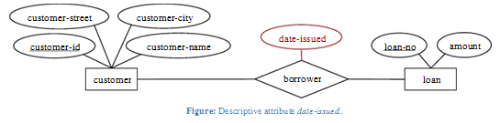
Relationship
A Relationship is an association among several entities.
A relationship may also have attributes
For example, consider the entity sets customer and loan and the relationship set borrower. We could associate the attribute date-issued to that relationship to specify the date when the loan was issued.
ERD Concepts

Slide 28
Relation
Relation has three Properties:
  Degree of Relationships
  Cardinality Constraint
  Participation Constraint

Slide 29
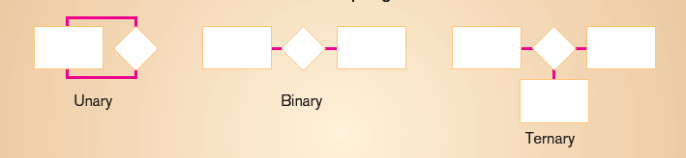
Degree of Relationships
Degree: number of entity types that participate in a relationship
Three cases
  Unary: between two instances of one entity type
  Binary: between the instances of two entity types
  Ternary: among the instances of three entity types

Slide 30
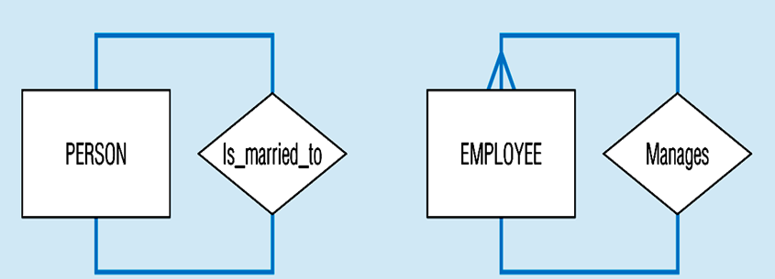
Recursive Relationship (Unary)
  Recursive Relationships - A relationship in which the same entity participates more than once.

Slide 31
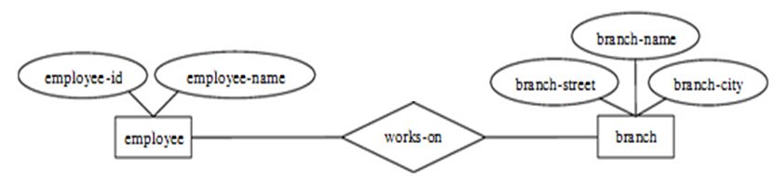
Binary Relationship
A binary relationship set is of degree 2.

Slide 32
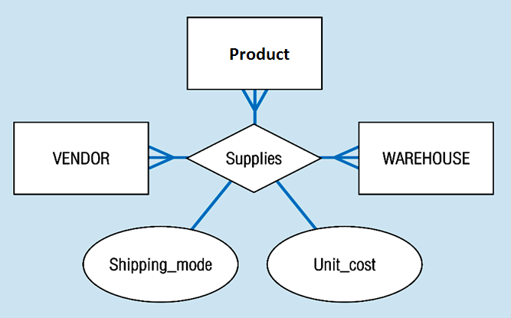
Ternary Relationship
ternary relationship set is of degree 3.

Slide 33
Cardinality
How many instances of one entity will or must be connected to a single instance from the other entities.
  One-One Relationship
  One-Many Relationship
  Many- Many Relationship
Notes:
Relationship: Establishes a connection or correspondence or link between a pair of tables in a database, or between a pair of entities in an entity-relationship diagram (ERD).
One-to-one relationship: A single record in table A is related to only one record in table B, and vice versa.
One-to-many relationship: A single record in table A can be related to one or more records in table B, but a single record in table B can be related to only one record in table A.
Many-to-many relationship: A single record in table A can be related to one or more records in table B, and vice versa. Problems with many-to-many relationships: one of the tables will contain a large amount of redundant data, both tables will contain some duplicate data, it will be difficult to add, update, delete records because of the duplication of fields between tables.

Slide 34
Cardinalities
1
own
1
Employee
Car
One-to-One
One-to-Many
Many-to-Many
1
has
M
Department
Employee
M
take
M
Course
Student
ERD Concepts

Slide 35
PARTICIPATION CONSTRAINT
An employee MUST work for a department
An employee entity can exist only if it participates in a WORKS_FOR relationship instance
So this participation is TOTAL
Only some employees manage departments
The participation is PARTIAL

Slide 36
PARTICIPATION CONSTRAINT
Has
Employee
Car
An Employee may have a car.
A Car must be assigned to particular employee

Slide 37
PARTICIPATION CONSTRAINT
Hire
Department
Employee
- A department may hire many employees ( Zero or more)
An employee must be employed by a department
(Department membership is Optional, Employee membership is Mandatory)

Slide 38
PARTICIPATION CONSTRAINT
Has
Employee
(0,1)
(1,1)
Car
work
Employee
(1,1)
(1,N)
Dept
A formal constraint: (min,max) where m, n are min and max number of times an entity participates in a relationship instance. For example, (0,10) means partial participation, and (1,max) means total participation.

Slide 39
Keys
Different Types of Keys:
  Candidate Key
  Primary Key
  Foreign Key
  Composite Key
  Partial Key
  Alternate key
  Super Key
ERD Concepts

Slide 40
Candidate Key
Candidate key: is a set of one or more attributes whose value can uniquely identify an entity in the entity set
  Any attribute in the candidate key cannot be omitted without destroying the uniqueness property of the candidate key.
Example:
  (SSN, Name) is NOT a candidate key .
  “SSN” is a candidate key of customer.
  Candidate key could have more than one attributes.
ERD Concepts
Notes:
It is minimal super key.
,
because taking out “name” still leaves “SSN” which can uniquely identify an entity.

Slide 41
Primary Key
Example: Both “SSN” and “License #” are candidate keys of Driver entity set.
Primary Key: is the candidate key that is chosen by the database designer as the unique identifier of an entity.
[Unique & Not Null]
Primary key May be Composite
ERD Concepts
Notes:
In building a database in a database software, the software will only allow to use one candidate key to be the unique identifier of an entity for an entity set.

Slide 42

Primary Key
The key is underlined
ERD Concepts
Notes:
In building a database in a database software, the software will only allow to use one candidate key to be the unique identifier of an entity for an entity set.

Slide 43

Summary of notation for ER diagrams
Identifying relationship is links strong entities to weak entities and represented with double line diamond

Slide 44
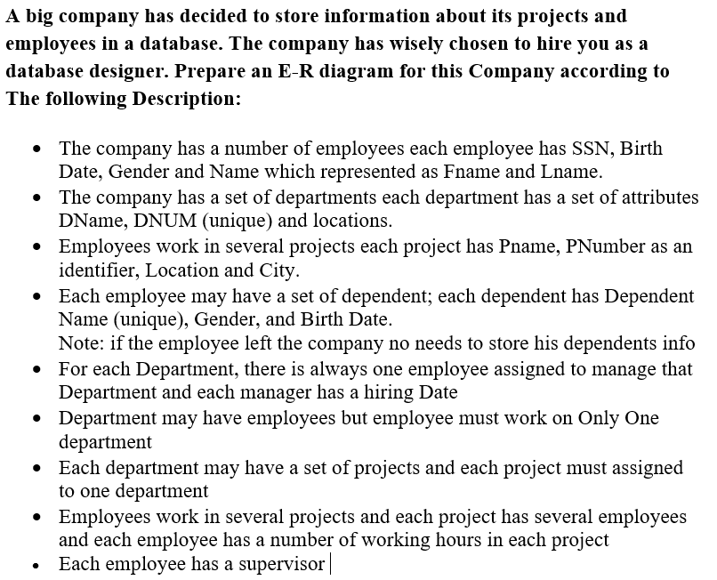
Use Case

Slide 45
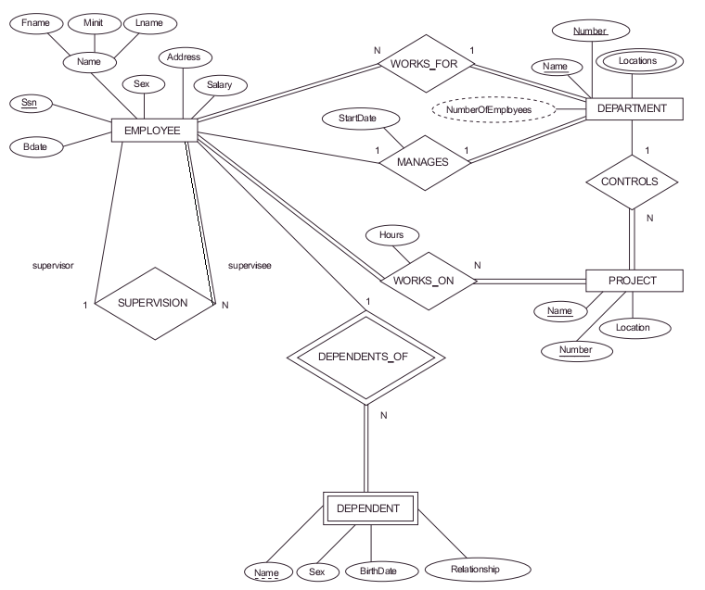

Slide 46

ERD Concepts

Slide 47
Thank You !!!
ERD Concepts

